Slide 1

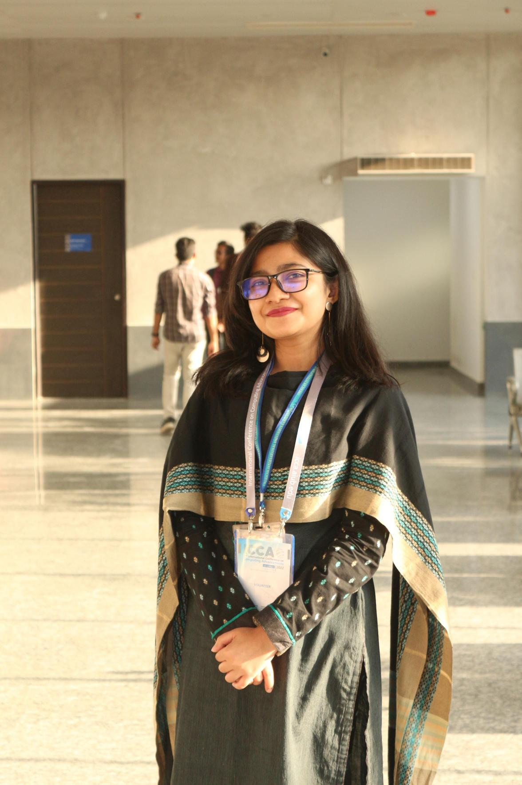
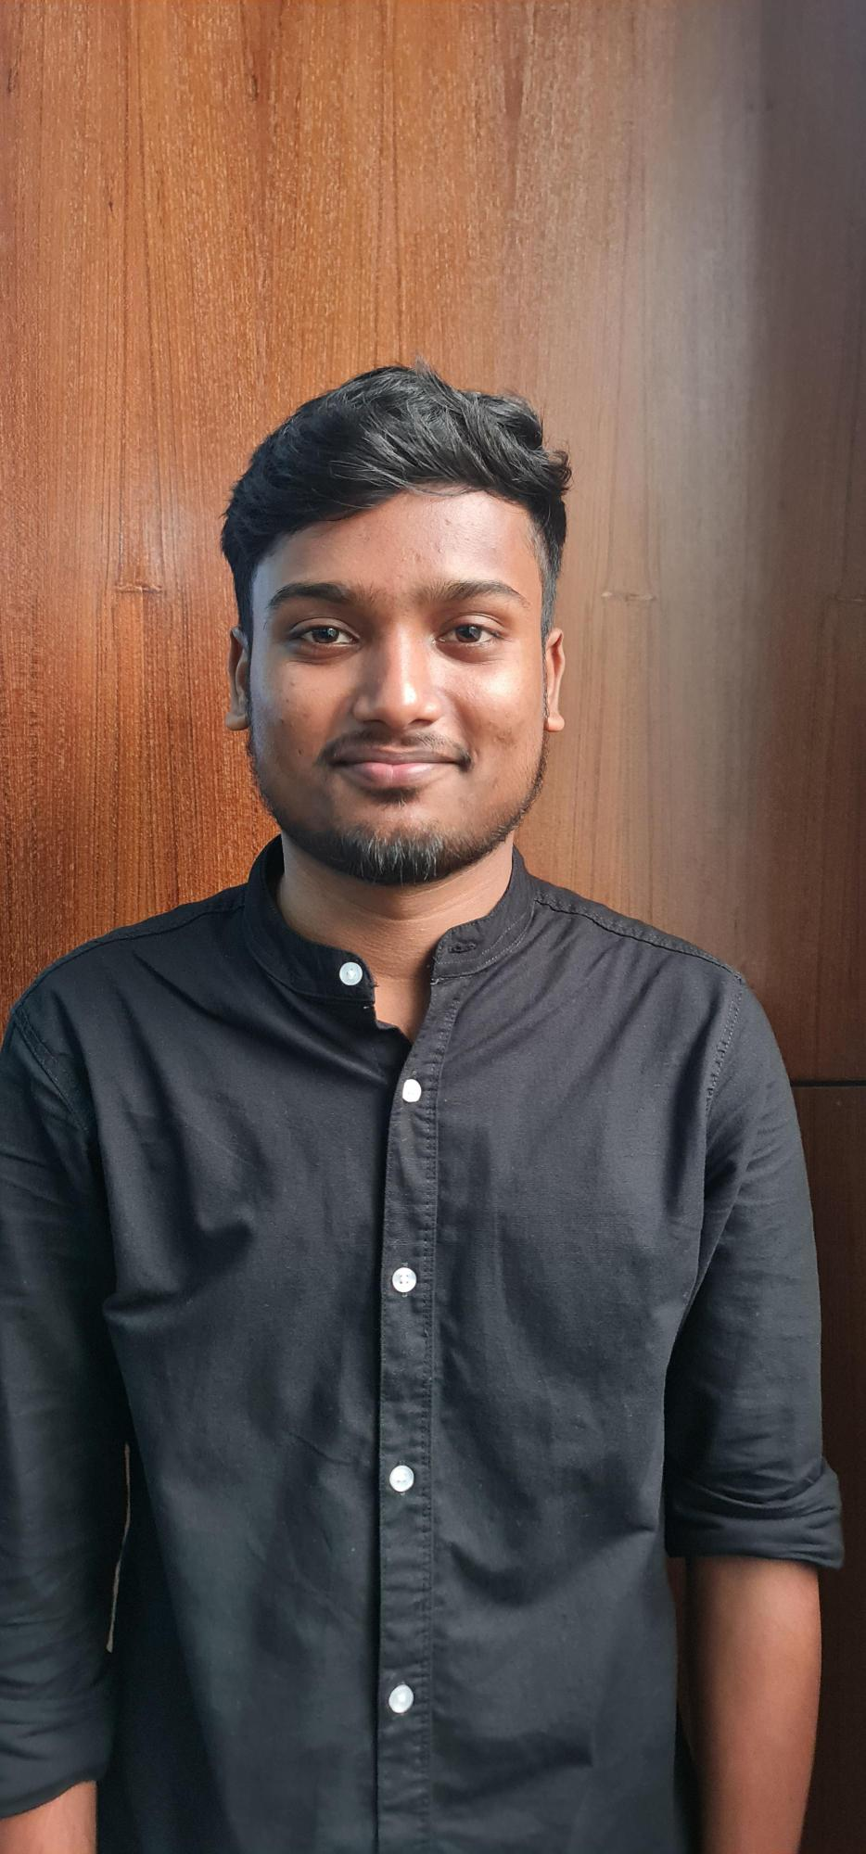
MD. ABDUS SHAKUR

Slide 2
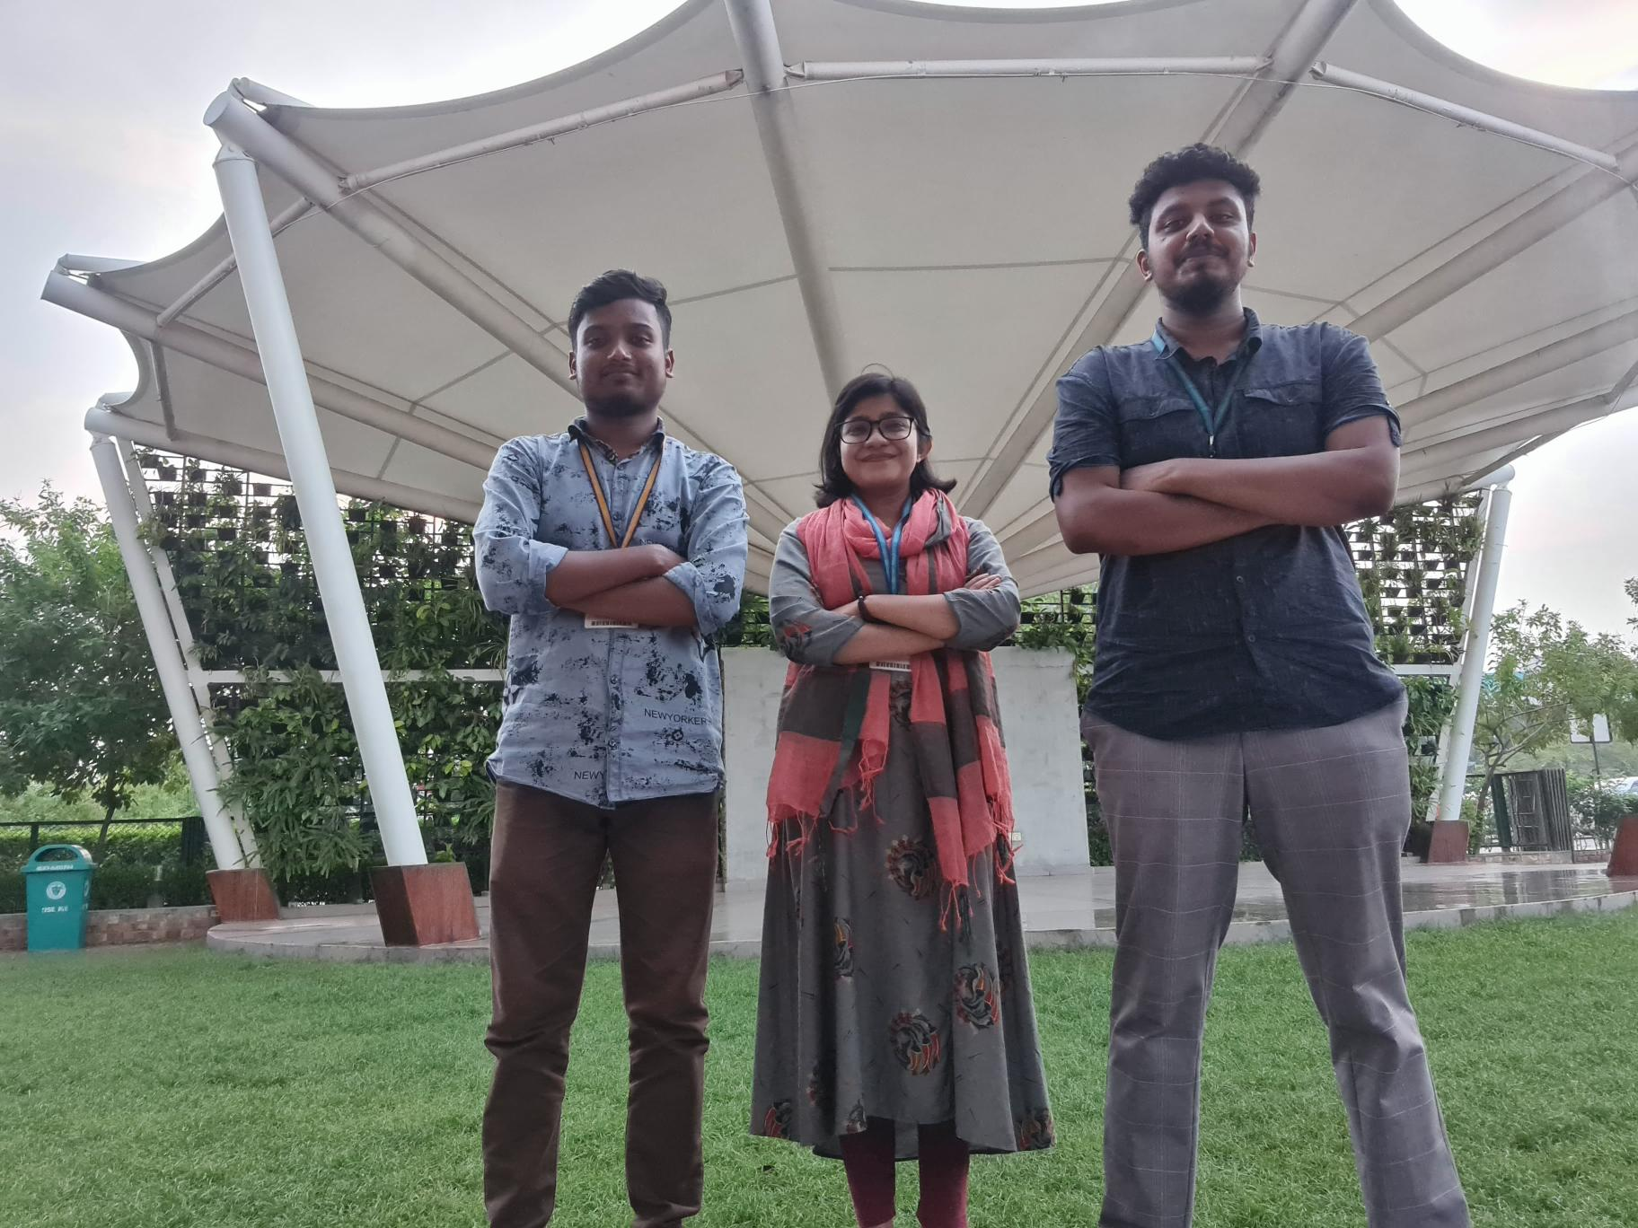
TEAM PB DEBUG
MD. ABDUS SHAKUR
SAYED RAYAN AHAMED KHAN
FATEMA TUZ ZUHURA

Slide 3
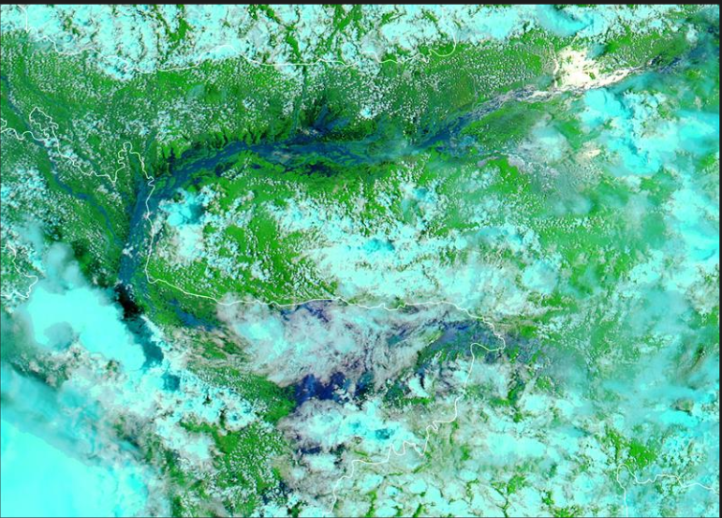
Sylhet June 22 from NASA EARTH OBSERVATORY

Slide 4

PROBLEM

Slide 5
SOLUTION

Slide 6

??????
NASA Space App Challenge

Slide 7
COURAGE
PASSION
CONFIDENCE

Slide 8
Courage
Passion
Confidents

Slide 9
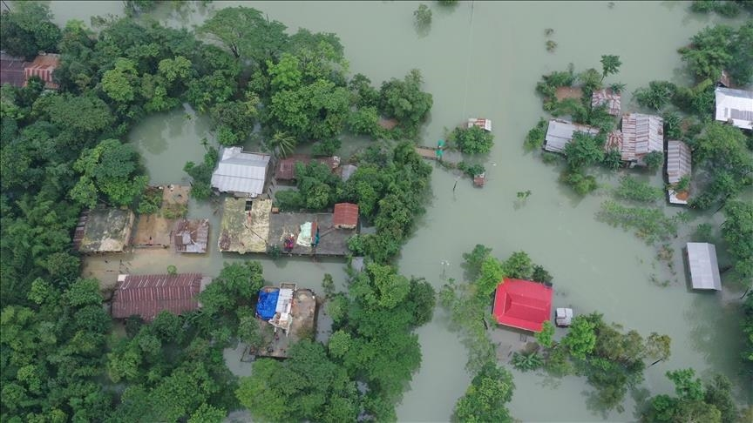

Slide 10
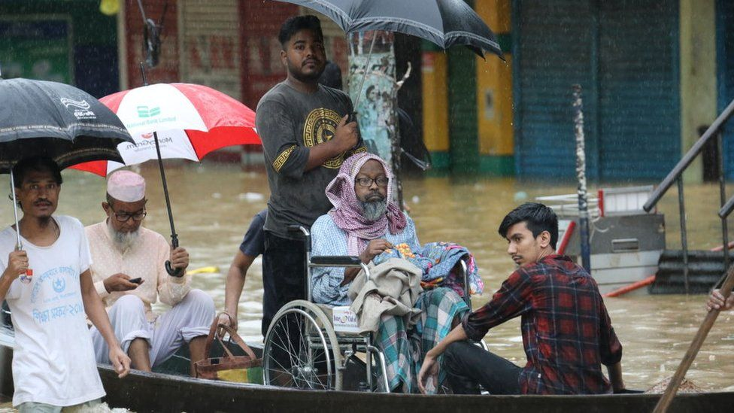

Slide 11
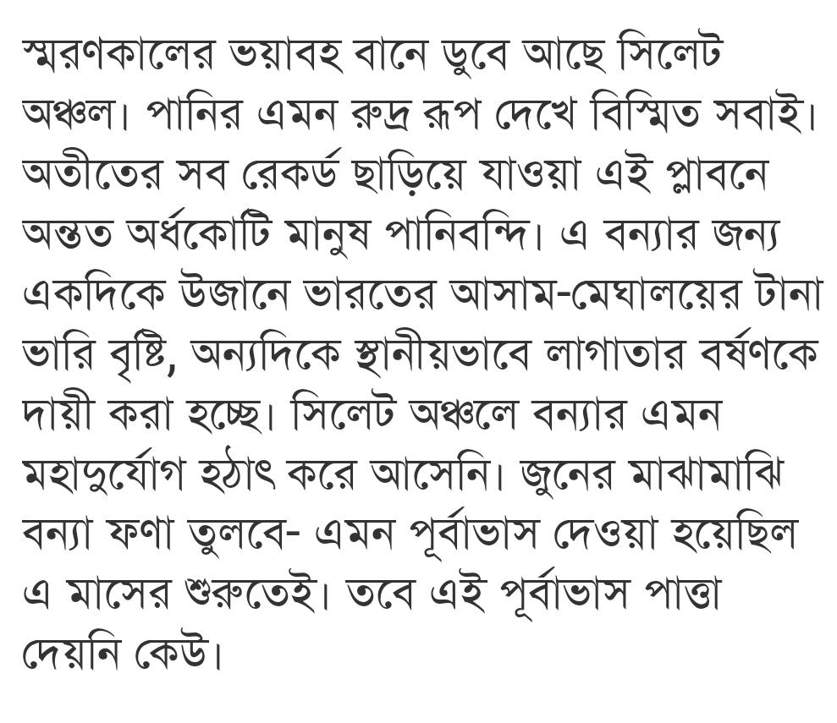
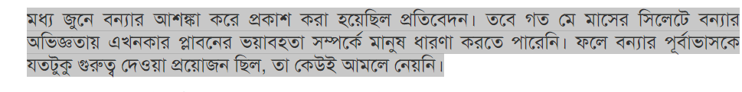
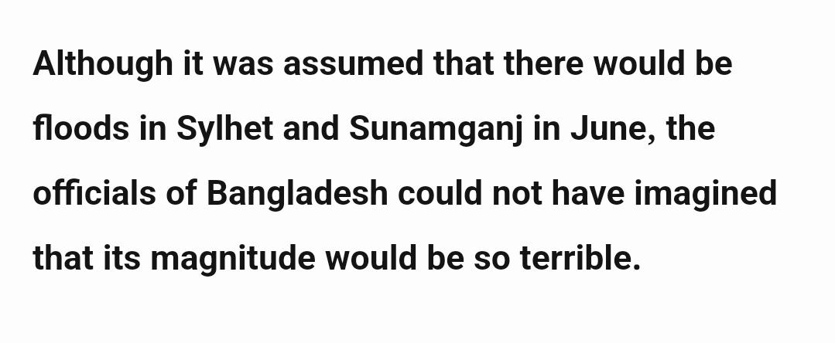

Slide 12


Slide 13


Slide 14
Display
Sensor 1
WLI ( Water Level Indicator)
Sensor 2
Sensor 3
Sensor 3

Slide 15
Store Data
Ultrasonic sensor
Water Level Heights
Time
Sensor 1
Sensor 2
Sensor 3
Send Data
Sensor 3
WLI ( Water Level Indicator)

Slide 16
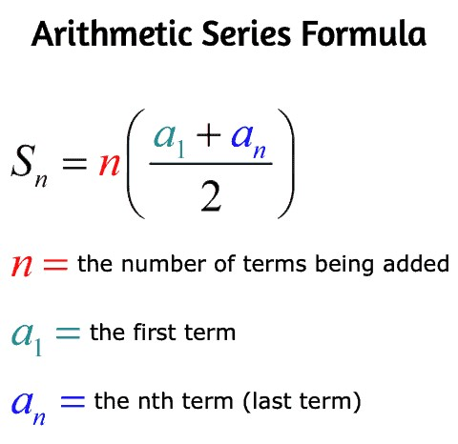
Calculate Data
Sensor 1 time:1:10 PM
Sensor 2 time:1:15 PM
Arithmetic Series
Sensor 3 time:1:30 PM
Sensor 4
Sensor 4 time: ?????
Sensor 3
Sensor 2
Sensor 1
WLI ( Water Level Indicator)

Slide 17
Sensor 4
Sensor 3
Sensor 2
Sensor 1
WLI ( Water Level Indicator)

Slide 18


Slide 19



